Slide 1

Giveth is rewarding and empowering those who give to projects, to society, and to the world!
with zero added fees

Slide 2




Using web3 to evolve philanthropy
Giveth is the best donation platform in the world!
Our community is focused on Building the Future of Giving using blockchain technology. Our intention is to support and reward the funding of public goods by creating open, transparent and free access to the revolutionary funding opportunities available within the Ethereum ecosystem.
100% of the donations go to the nonprofits and donors are rewarded with GIVbacks.
Provide value for society
Build systems to protect the resources
Build strong incentive systems to protect both the community and individuals
Bring innovation into the public goods space

Slide 3
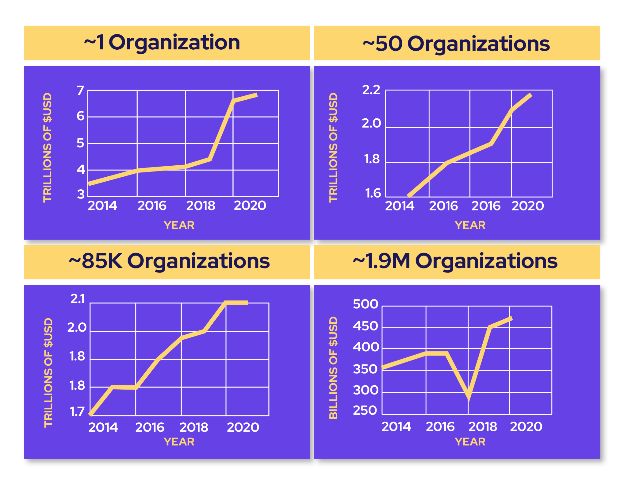
The right time for disruption is NOW!
Public goods it the most overlooked web3 opportunity.
Federal, state, local governments (in the US alone), and US nonprofits are spending $10.5 TRILLION per annum in this sector: over 5x Total crypto market cap!
US government donates +500B USD every year through nonprofits but the problem isn’t being solved anytime soon.
We have the opportunity to disrupt this sector in web3.

Slide 4

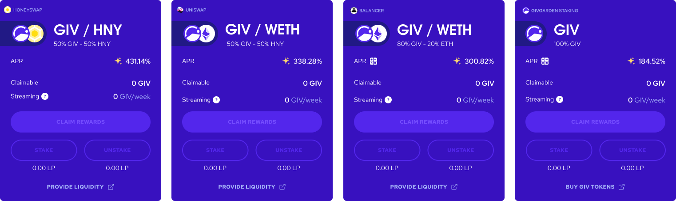
Giveth offers lucrative rewards while attracting and rewarding long-term hodlers
The GIVfarm launched on December 24, 2021. 3.5% of the total token supply, 35 Million GIV, has been allocated to the first GIVfarm round of 6 months, 65 million tokens are held in a multisig for future liquidity provision.
To create more liquidity, we are planning to launch $oneGIV and make a protocol owned Giveth Angel Vault. This way we can protect the value of $GIV for GIVbacks, the GIVgarden & all our future ventures.

Slide 5
Giveth offers lucrative rewards while attracting and rewarding long-term hodlers
The GIVfarm provides 4 liquidity farms - 2 on Mainnet and 2 on Gnosis chain - as well as single asset GIV staking on both chains. APRs range from 200% to 450%.
The GIVstream is another novel concept pioneered by Giveth. When you harvest rewards from the GIVfarm you are not only earning instantly claimable rewards but also receiving and augmenting your own personal continuous stream of GIV.

Slide 6
Our growth plan - the best is yet to come
Angel Vault and path to our stable token (oneGIV)
To create more liquidity, we are planning to launch $oneGIV and make a protocol owned Giveth Angel Vault. This way we can protect the value of $GIV for GIVbacks, the GIVgarden & all our future ventures. $oneGIV will be used throughout the GIVeconomy.
2022
GIVpower
$GIV holders will be able to lock their tokens to BOOST projects asking for donations on our platform. The longer they lock, the more the project is BOOSTED and the higher their staking APR.
2022
GIVfi
Latent donations on the platform will be put into safe defi strategies to earn an interest while waiting for projects to withdraw them. This interest will be used to buy $GIV on secondary markets.
2023
Regen Microeconomies Market powered by $GIV
With the $GIV staked behind projects via GIVpower, we can enable for-good projects to launch their own microeconomies backed by $GIV in a Bonding Curve. Donors become investors, Volunteers become shareholders with a voice. This is the Future of Giving.
Future

Slide 7
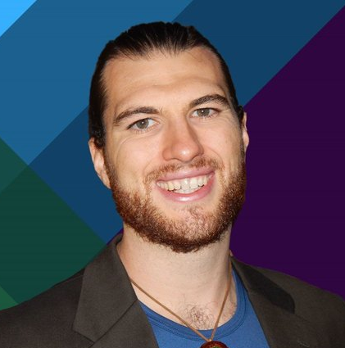







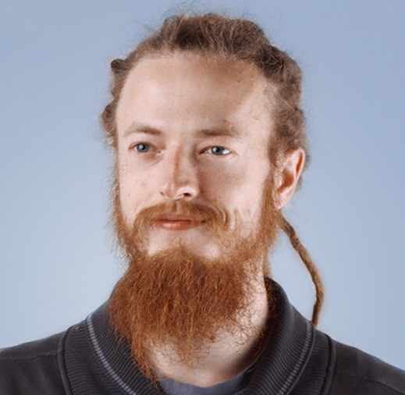
Giveth DAO
Griff Green
co-Founder of The Commons
Stack, Giveth.io. Also co-founded DAppNode and White Hat Group (WHG).
Jordi Baylina
co-founder of Giveth, DAppNode
and Founder and Technical Lead of Hermez Network and iden3.
Marko Prljic
Design scientist. Human behavior, interaction principles and design.
Lauren Luz
Giveth communications lead and GIVeconomy project management.
Mitch @divine_comedian
Blockchain Writer, Junior
Developer, DAO steward.
Willy Ogorzaly
Head of Decentralization at Fox Foundation. Former CEO @bitfract acq: ShapeShift @JustLegal acq: DigitalTown.
Eduardo Antuña
DAppNode co-founder and
project lead. Ethereum DevOps and Solidity developer.
Sem @404ouch
Software engineer 1hive, giveth.
Smart contract developer. Building GIVpower.
Oleksii Matiiasevych
Etherium architect,
Smart Contracts Engineer.

Slide 8



We are selling 1 mil $GIV via an OTC!
Staking Pools
Chain
Buy $GIV at a discounted rate and stake it with a higher reward in GIVfarm.
3% discount on $GIV tokens with voting rights > staking in GIVfarm possible - earn rewards
80GIV/20ETH Balancer
Mainnet
GIV Staking
Mainnet
GIV/HNY Honeyswap
Gnosis Chain
GIV/WETH Sushiwap
Gnosis Chain
GIVgardens Staking
Gnosis Chain
We will be selling the $GIV tokens prior to launching the Angel Vault (AV).
After launching the AV and building a buy-wall with stable tokens, the GIV price will be stabilized and protected against major downward volatility while improving our APR rates.
After Launching ICHI Angel Vault
(at $0.40 $GIV)
Now
Total GIV Staked
6.8mill
9.3mill
APR
181%
132%

Slide 9


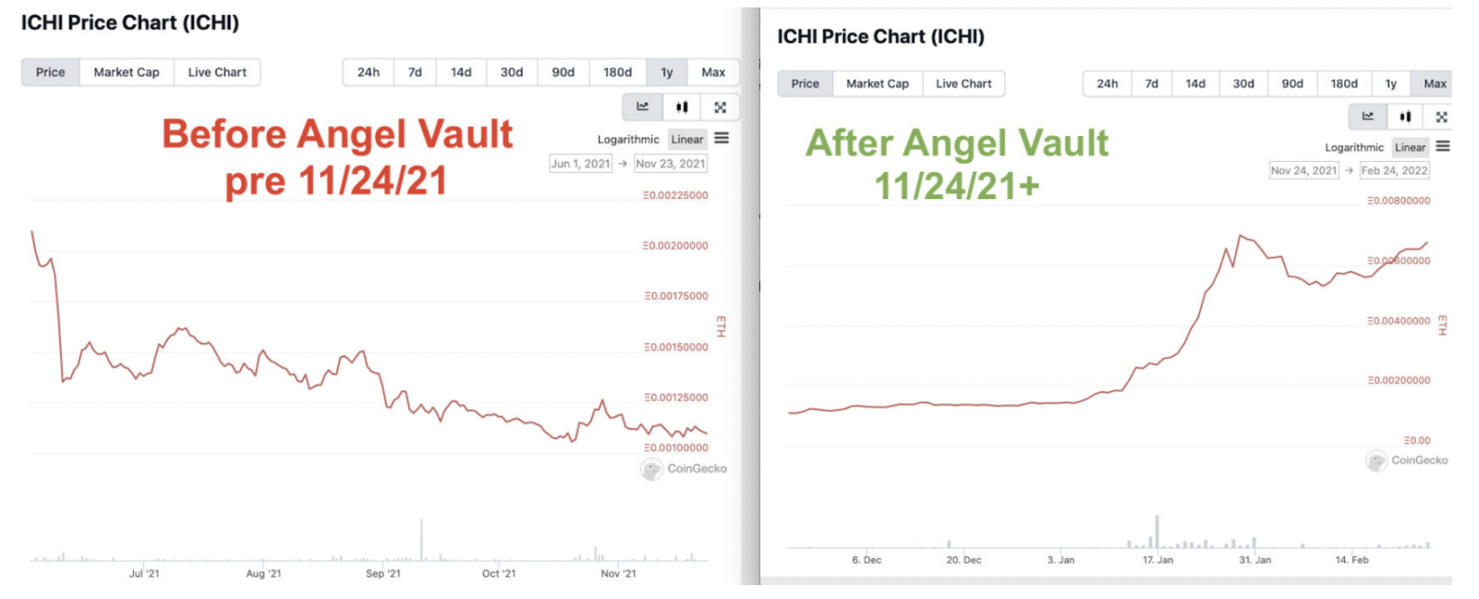

Giveth Angel Vault would create a MASSIVE buy wall on Univ3
Benefits for Giveth: Launching oneGIV stablecoin in the Angel Vault will create a massive buy-wall which supports GIV token price. This will also help with market-wide volatility and cap the impact of market down pressure, but capitalize on the up market. A great example of this practice is ICHI:
Angel Vaults provide protection against price declines while providing high income.

Slide 10
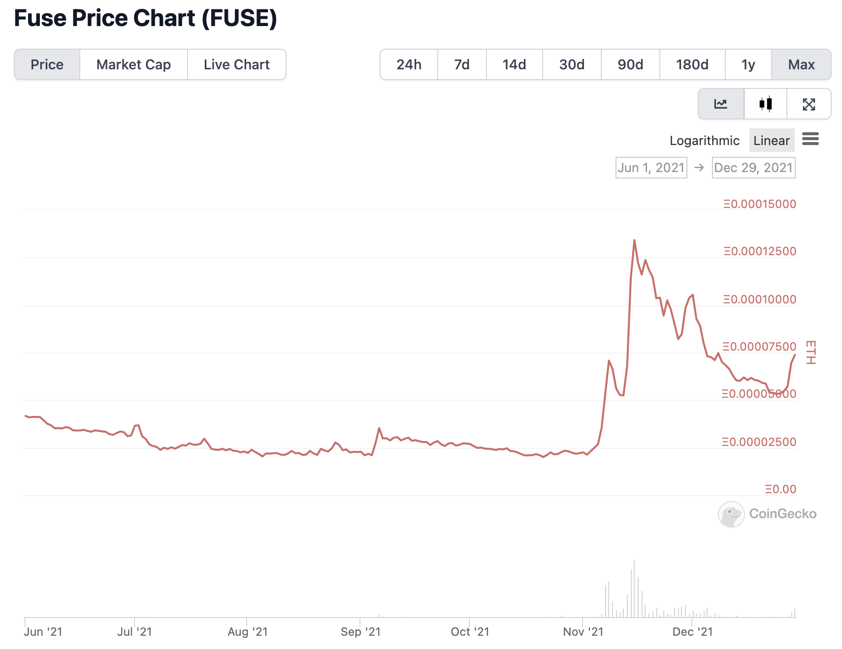
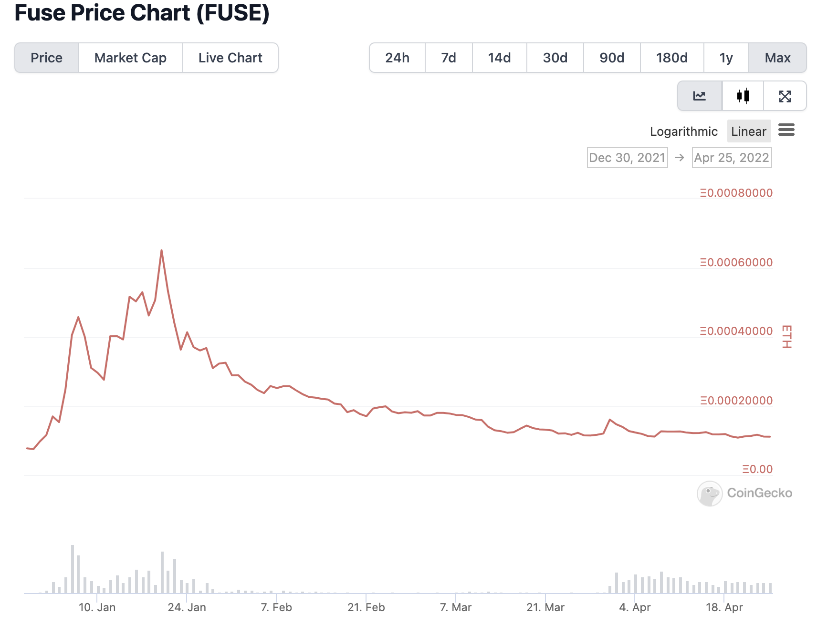
Giveth Angel Vault would create a MASSIVE buy wall on Univ3
Benefits for Giveth: Launching oneGIV stablecoin in the Angel Vault will create a massive buy-wall which supports GIV token price. This will also help with market-wide volatility and cap the impact of market down pressure, but capitalize on the up market. One example of this practice is FUSE:
Angel Vaults provide protection against price declines while providing high income.
Before Angel Vault 12/30/2021
After Angel Vault 12/30/2021+

Slide 11
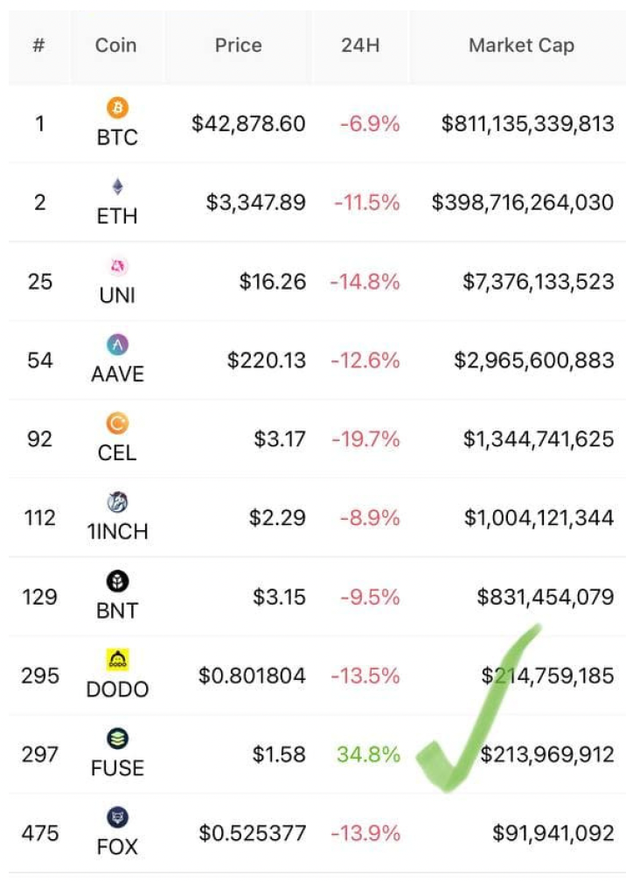
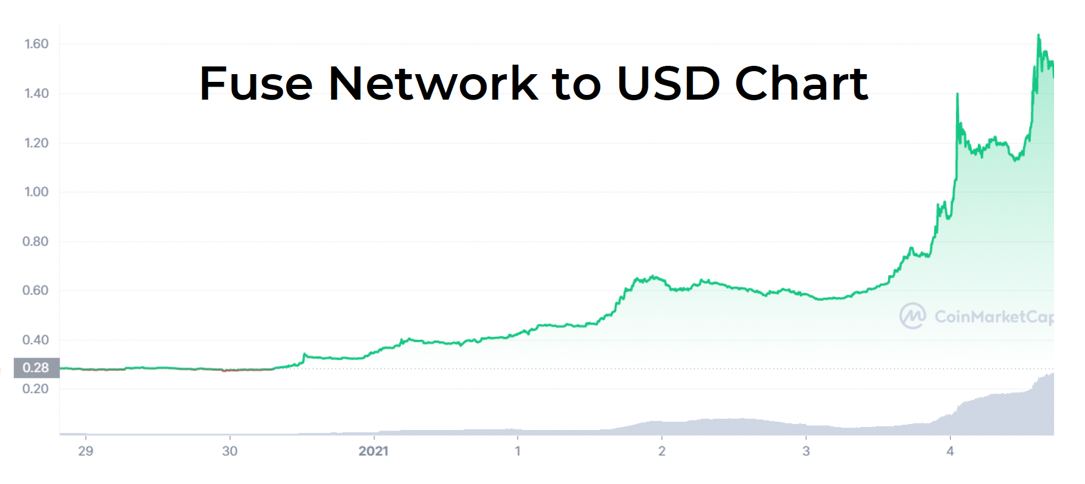
Angel Vault would protect against downward volatility
In the first week after launching FUSE/oneFUSE vault, the price of $FUSE rose from $.28 to $1.60. It also provided stability to the prices during a large market crash.

Slide 12


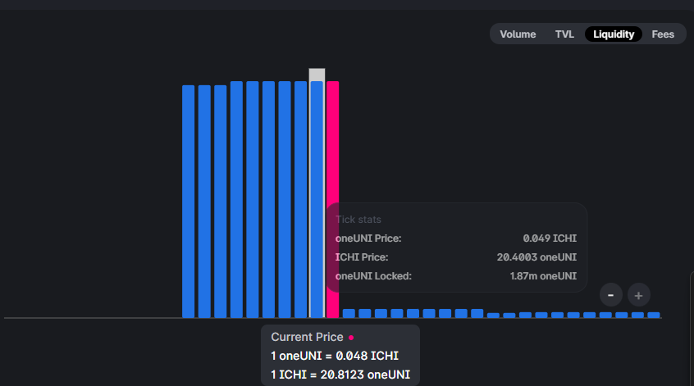
Giveth Angel Vault (example)
An Angel Liquidity Vault is a Uniswap V3 liquidity management tool that allows crypto projects and DeFi users to earn better fees without having to manage their concentrated pool positions.
Example: Pairing stable token with their native token (ICHI-oneUNI case study). Where the red bar represents the spot price of the native crypto asset, and the tall blue bars to the left represent liquidity in the deposit token (stable asset) concentrated underneath the price as buy orders for the crypto asset. At and above the spot price, the Vault will place liquidity in the native asset as sell (take profit) orders. This purchase liquidity is managed by the Angel Vault protocol, protects against price declines, and earns high income. Selling 10% of circulating ICHI only has a -7% price impact

Slide 13
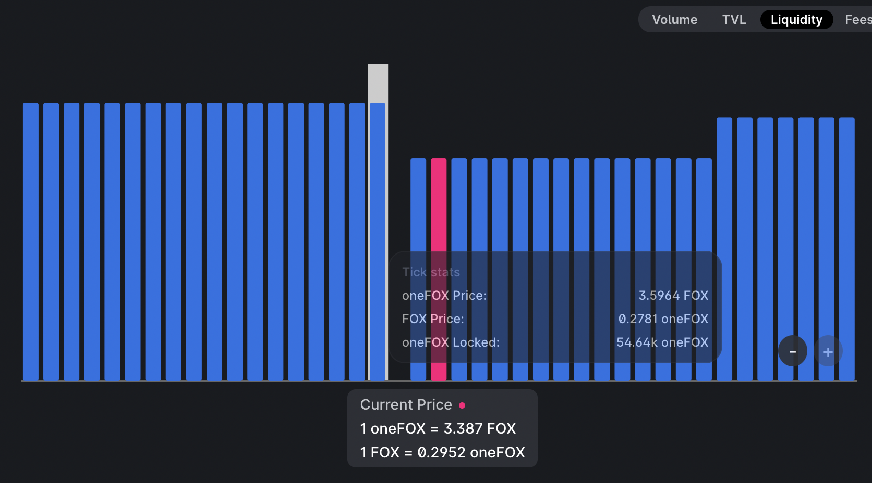
Giveth Angel Vault (example)
An Angel Liquidity Vault is a Uniswap V3 liquidity management tool that allows crypto projects and DeFi users to earn better fees without having to manage their concentrated pool positions.
Example: Pairing stable token with their native token (FOX-oneFOX case study). Where the red bar represents the spot price of the native crypto asset, and the tall blue bars to the left represent liquidity in the deposit token (stable asset) concentrated underneath the price as buy orders for the crypto asset. At and above the spot price, the Vault will place liquidity in the native asset as sell (take profit) orders. This purchase liquidity is managed by the Angel Vault protocol, protects against price declines, and earns high income.

Slide 14
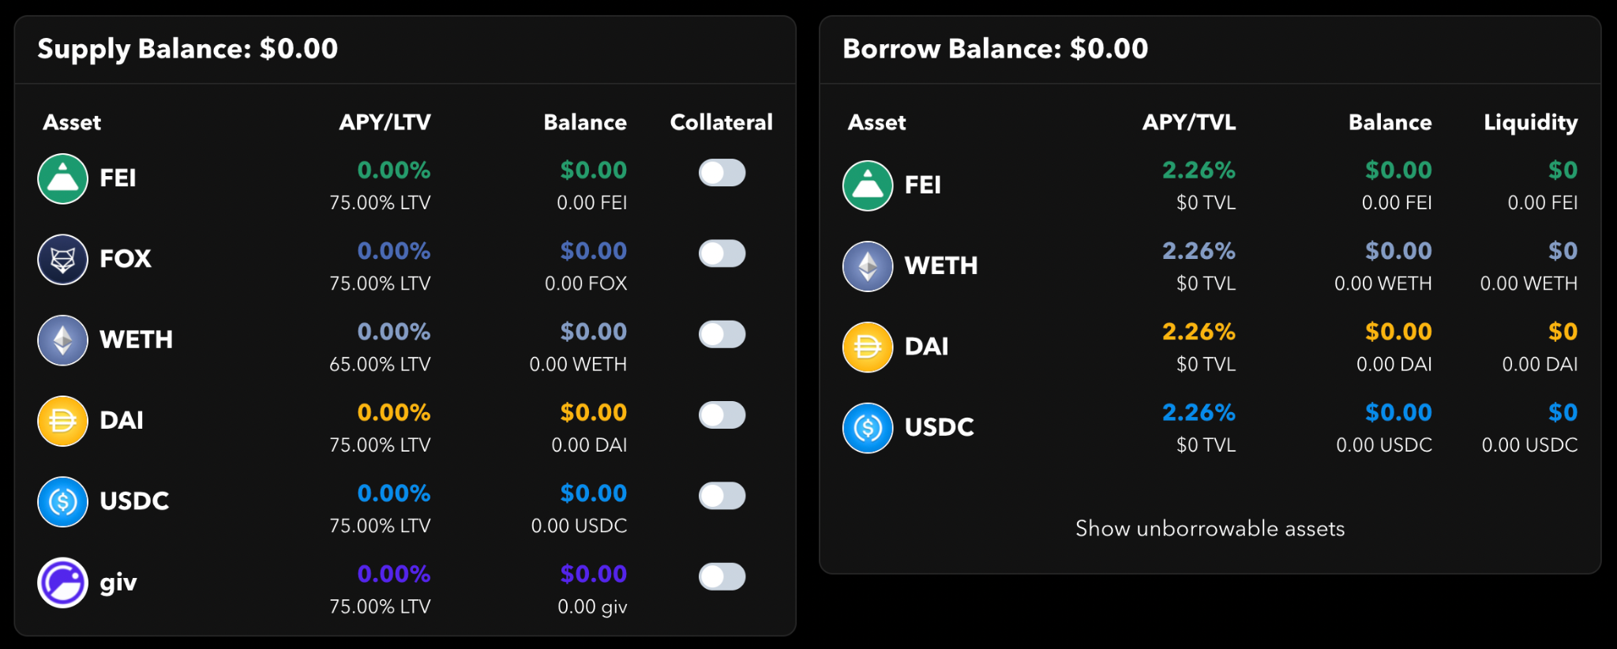
Regen pool on Rari’s Capital Fuse soon LIVE!
We have deployed the Regen Pool which enables the blockchain4good community, especially GIV HODLers to borrow against the community assets - deposit FEI and earn up to 30% APR in lending fees and $GIV incentives.
We will use GIV tokens to borrow the FEI and use them to fuel our Angel Vault on ICHI which will protect the $GIV price and provide an additional layer of comfort for GIV HODLers who plan to use the asset as collateral when borrowing on Rari Capital.

Slide 15

Join us in Building the
Future of Giving

